Slide 1
USC Mafia Wars

Slide 2
Overview
What is USC Mafia Wars?
Topics Outside Curriculum
Outside Software and Tools
Project Design and Teamwork
Use of Other Classes
Data Structures
Networking/Multithreading
User Login
Demo

Slide 3
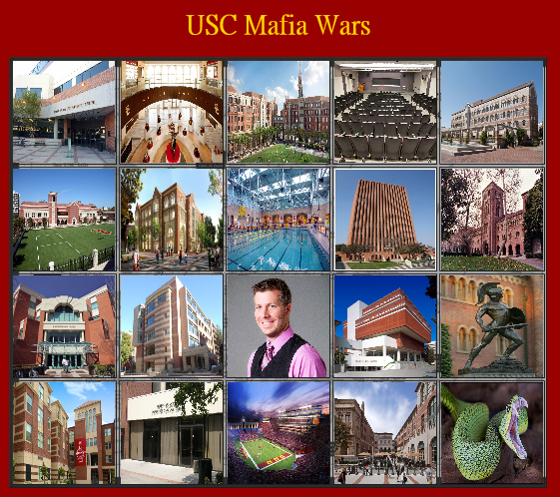
What is USC Mafia Wars?
Customize and build your best USC
Buy USC Buildings and Sports teams
Accumulate money, increase attribute levels
Battle players

Slide 4



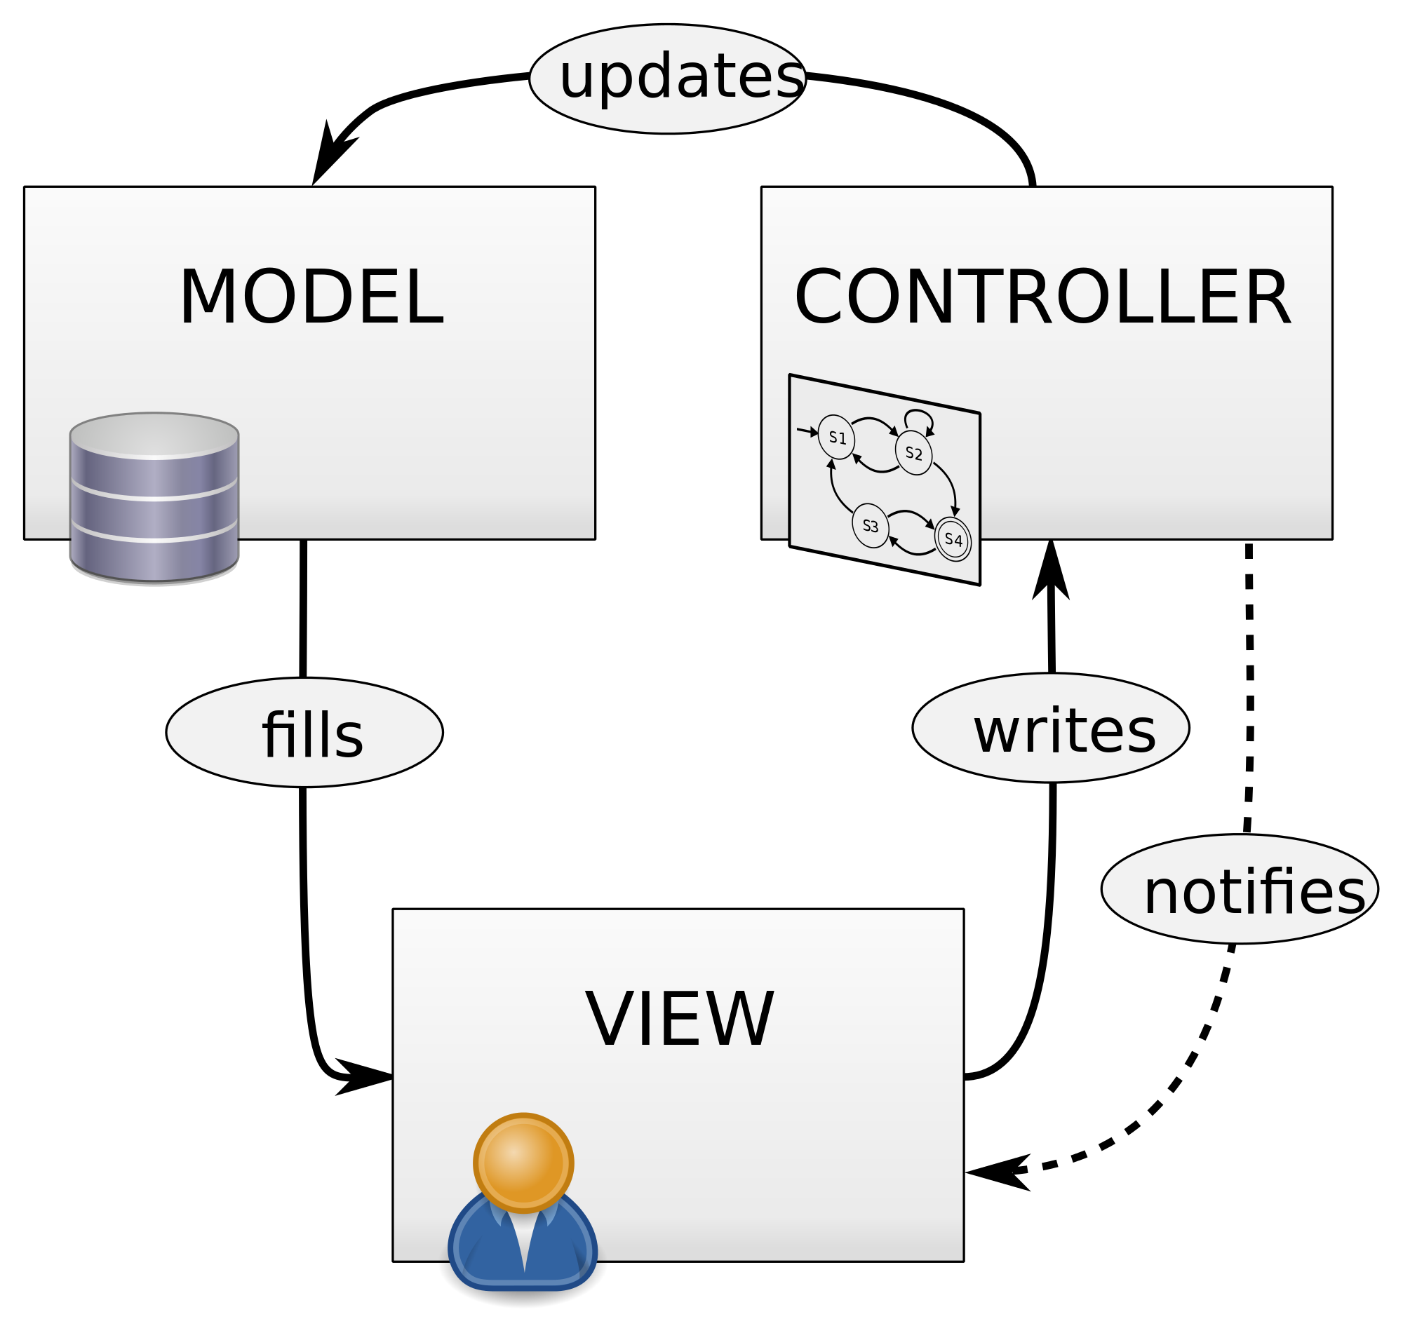


Topics Outside Curriculum
Code sharing
JQuery
Image Manipulation
JavaFX
Animation
Internationalization/Localization
MVC (Model View Control)
Notes:
Need at least 7 topics from outside curriculum

Slide 5








Outside Software and Tools
1.
2.
3.
4.
5.
6.
7.
8.
Notes:
***Should this only be tools/software from outside the class??*** (Need at least 7)
Communication: FB Messenger, Slack
Documentation: Google Drive, Google Docs
Code Sharing: GitHub, Slack
Presentation: Microsoft Publisher
Database Schema: Gliffy
General Help: YouTube, Stack Overflow
Languages: Java, Javascript, HTML, CSS, SQL
IDE: Eclipse

Slide 6

Project Design and Teamwork
Worked Well
Meeting regularly
Each team member focused on certain aspect of project
End of each meeting: discuss next course of action, book library rooms for next meeting
Didn’t Work Well
Communication
Issues when trying to use GitHub and branching
Changing Java structures required changing database structures

Slide 7

Use of Other Classes
ITP 368: Graphical User Interfaces
ITP 380: Video Game Programming
CSCI 103: Introduction to Programming
CSCI 104: Data Structures & Object Oriented Design
WRIT 340: Communication for Engineers
BUAD 301: Technical Entrepreneurship
Notes:
ITP 368: Functional programming, better understanding of GUI’s, design patterns, animations, Internationalization/Localization
CSCI 103: Foundational understanding of programming concepts and basic data structures
CSCI 104: Foundational understanding of data structures used in this project
WRIT 340: prior experience with technical documentation
BUAD 301: experience developing concept and product, planning execution

Slide 8
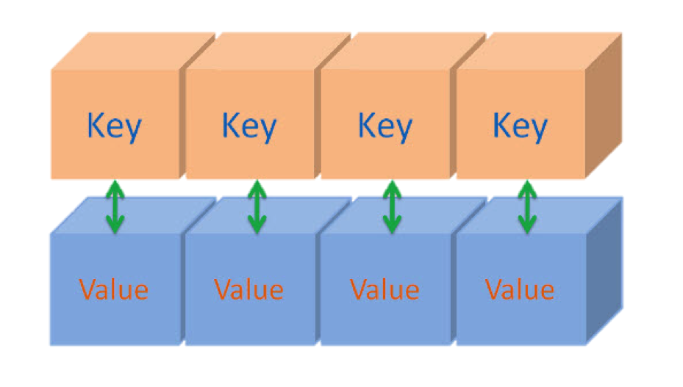
Data Structures
ArrayList
HashMap
Set
Array
Vector
0 1 2 3 4 5 6 7 8 9
{ , , , }
Notes:
Need at least 5,

Slide 9


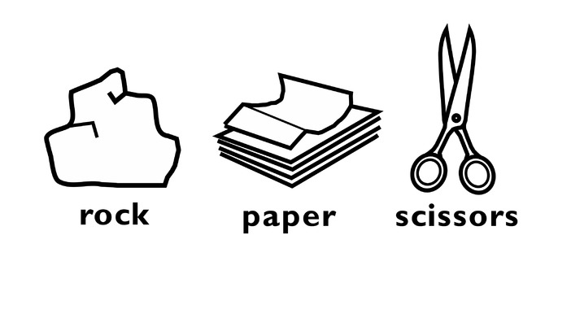

Networking/Multithreading
AJAX and servlets for networking
Players initiate requests, access servlet
Servlet creates thread, starts game, processes input
Users can “battle” each other in Rock Paper Scissors game

Slide 10
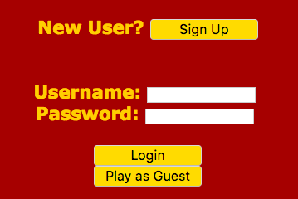
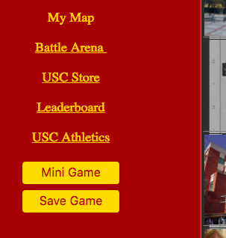
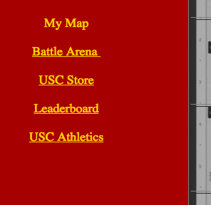
User Login
Sign up to become registered user
Login if registered user
Previously saved game state loaded
Access to an extra side game
Play as guest
Cannot save game status for later
Notes:
Sign up to be registered user
Login if already registered
username/password
Authenticated against SQL database
Previously saved game state loaded
Play as guest
Cannot save game state

Slide 11
DEMO

